Slide 1
Module IV

Slide 2
Module IV
Concepts of Agile Development methodology; Scrum Framework.
Software testing principles, Program inspections, Program walkthroughs, Program reviews; Blackbox testing: Equivalence class testing, Boundary value testing, Decision table testing, Pairwise testing, State transition testing, Use-case testing; White box testing: control flow testing, Data flow testing.
Testing automation: Defect life cycle; Regression testing, Testing automation; Testing non-functional requirements.

Slide 3
Introduction
It is an agile software development method.
It is conceived by Jeff Sutherland and his team.
Further development was performed by Schwaber and Beedle.
Scrum principles are consistent with the agile manifesto and are used to guide development activities within a process that incorporates the following framework activities:
Requirements Analysis.
Design.
Evolution.
Delivery framework activity.
Work tasks occur within a process pattern called a sprint.
It gives more importance for the following:
Tight timelines
Changing requirements
Business criticality.
Each of these process patterns defines a set of development actions:

Slide 4
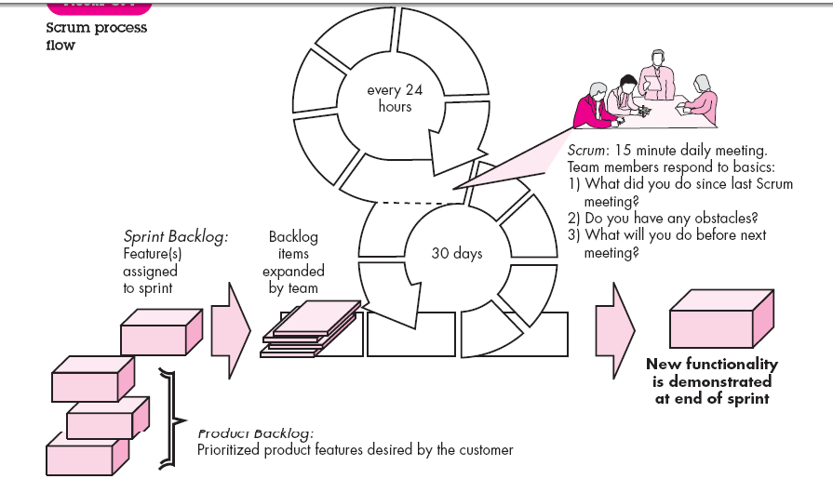

Slide 5
Continues…
Backlog
A prioritized list of project requirements or features that provide business value for the customer. Items can be added to the backlog at any time (this is how changes are introduced).
The product manager assesses the backlog and updates priorities as required.
Sprints
It consists of work units that are required to achieve a requirement defined in the backlog that must be fit into a predefined time-box (typically 30 days).
Changes (e.g., backlog work items) are not introduced during the sprint. Hence, the sprint allows team members to work in a short-term, but stable environment.
Scrum meetings
Are short (typically 15 minutes) meetings held daily by the Scrum team. Three key questions are asked and answered by all team members :
• What did you do since the last team meeting?
• What obstacles are you encountering?
• What do you plan to accomplish by the next team meeting?

Slide 6
Continues..
A team leader, called a Scrum master, leads the meeting and assesses the responses from each person.
The Scrum meeting helps the team to uncover potential problems as early as possible.
Also, these daily meetings lead to “knowledge socialization” and thereby promote a self-organizing team structure.
Demos
Deliver the software increment to the customer so that functionality that has been implemented can be demonstrated and evaluated by the customer.
It is important to note that the demo may not contain all planned functionality, but rather those functions that can be delivered within the time-box that was established.

Slide 7
Scrum Roles
The members of a Scrum team play three roles.
Product owner
Team member
Scrum Master

Slide 8
Product Owner
Represents the customers, users, and other stakeholders.
The product owner writes user stories to describe the project’s goals and then prioritizes them.
The resulting prioritized list of wanted features is called the product backlog.
The product owner has the following duties.
Defines the requirements and verifies that the product meets those requirements.
Sets requirement priorities; helps determine which requirements make it into the next iteration given resource constraints.
Plans and announces releases
Provides a point of contact between the stakeholders and developers.
The product owner generally shouldn’t modify an iteration while it is underway; although, he can make changes in the next iteration and can cancel an iteration if necessary.

Slide 9
Team member
These are the self‐organized cross‐functional team members who build the application.
During each iteration, each team member helps handle all the typical tasks you need to write a decent piece of software (analysis, design, program, test, document, and so forth).

Slide 10
Scrum Master
The Scrum Master acts as a remover of obstacles for the team.
This person also ensures that the team follows good Scrum practices, challenges the team to improve, and sometimes leads meetings.

Slide 11
Scrum Sprints
A Scrum project creates a series of timeboxed incremental iterations, which are usually called sprints .
In traditional Scrum, a sprint is 30 days long; although some people prefer shorter sprints of one, two, or three weeks.
The result of each sprint is a fully tested and approved piece of software, which is sometimes called a potentially shippable increment ( PSI ).
Before each sprint begins, the team holds a sprint planning meeting . The meeting is timeboxed to four hours so that it doesn’t take up too much time.
During that meeting, the product owner decides which user stories should be selected for the upcoming sprint.
The goal is to provide the greatest benefit to the users in each iteration, so the most useful items should be selected. Fixes for any outstanding bugs should also be included.

Slide 12
The developers can ask for clarification and point out any potential problems. When the meeting is done, the selected items are moved from the product backlog into the sprint backlog .
After the sprint’s goals and tasks have been defined, the developers roll up their sleeves, divide up the tasks, and really get to work. They analyze the tasks, design solutions, write code, and test.
During the sprint, the team holds a quick 10–15 minute daily scrum (sometimes called a “standup,” where each developer answers the Three Questions of Agile Development:
What did you do since the last scrum?
What do you hope to accomplish before the next scrum?
What obstacles do you see in your way?

Slide 13
Continues..
If a developer sees obstacles, the Scrum Master looks into them.
After all the work is done, the sprint ends with a sprint review meeting .
The development team presents the current PSI to the product owner, who checks the results against the items that were originally selected for the sprint to make sure the sprint’s goals have been met.
If the application can’t handle even part of any of the user stories, the product owner can flag that story as unfinished.
After the sprint review meeting, the Scrum Master and the development team hold a retrospective meeting where they discuss the recent sprint.
Here they discuss the three big questions about any development method and particularly any iterative method:
What went well and how can we make it happen again?
What went poorly and how can we avoid that in the future?
How can we improve the next sprint?

Slide 14
Burndown Charts
Also called release burndown chart.
Scrum uses burndown charts to measure progress.
A burndown chart shows the amount of work remaining plotted over time.
A sprint burndown chart shows the amount of work for a sprint.
You can measure the amount of work in story points, expected number of hours of work, or any other measurement you find useful.
You can let the chart’s X‐axis show the date or, for a project burndown chart, the sprint number.

Slide 15
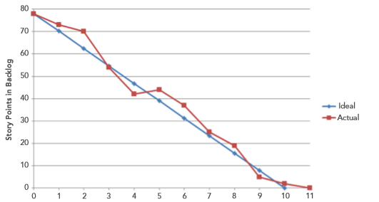
Example

Slide 16
Project Velocity
A project’s velocity represents the amount of work the team can perform during a sprint.
To calculate the velocity during a sprint, simply add up the number of features the sprint delivered.
To calculate the number of features, you can use story points, backlog items, or any other measure that you find useful.
For example
Suppose your team implements 12 story points during a sprint.
Then the velocity during that sprint is 12.
Usually, after a few sprints the team’s velocity becomes relatively stable and you can use it to estimate how much work future sprints can accomplish

Slide 17
Reasons why velocity might fluctuate?
For example, Scrum teams are usually fairly small , so adding or removing a single person can make a big difference.
Removing one person from a four‐person project means losing 25 percent of your staff.
Velocity will also vary if you change the length of the sprints; for example, switching from four weeks to two weeks.

Slide 18
Agile Estimation
‘Story Point’ is the measure of size (or complexity) of user stories in agile projects.
‘Ideal Days’ is the measure of effort in agile projects, which is the number of days a task will take if one person does that task without any interruptions.
‘Velocity’ is the sum of story points delivered by a team per cycle of iteration (sprint).
Explained in next slides
Two commonly used estimation techniques for agile projects are:
Delphi Wideband
Planning Poker

Slide 19
Story Points
Relative & indirect measure of complexity of user stories.
Complexity assessed & story points estimated in comparison with a baseline story.
Baseline story need not be the smallest one; it should be the one which all team members can relate to.
For example, consider following user stories to estimate:
Story 1 : A login screen to be developed
Story 2 : A screen for entering customer data is required.
Story 3 : A mailing module to send periodic mails to the customers.
User story 2 – customer data entry screen may be taken as the baseline story, since all team members can clearly understand this functionality.
Assign a story point of 6 (any arbitrary number) for the user story 2 - customer data entry screen .
Complexity of all other user stories will be compared with the customer data entry screen & assigned a relative story point.
For every team, story size could mean different things depending on what baseline they chose.
Story points of different projects / teams are not comparable.

Slide 20
Continues..
Story points are a relative measure to represent complexity of user stories in comparison with a baseline story. So, story points could be:
1, 2, 3, 4, …, 10
10, 20, 30, …, 100
1, 2, 4, 8 and 16
0, 1, 2, 3, 5, 8 and 13 (Fibonacci series)
S, M, L, XL, XXL
Cat, Dog, Lion and Elephant
Team members should have clear understanding of the scale they use for story points.
Story points are converted to ideal days using the average velocity of previous sprints.

Slide 21
Planning Game
Planning poker(also called Scrum poker ) is a game you can play to decide how much work a particular task might be.
Each team member gets a deck of cards with values based roughly on the Fibonacci sequence. In that sequence, each number is the sum of the two previous numbers: 0, 1, 1, 2, 3, 5, 8, 13, 21, etc.
Some decks also include a question mark card to indicate that an item will take an unknown amount of time and a coffee cup card to indicate that you need a break.

Slide 22
Continues..
After everyone has a card deck, the game begins. The meeting moderator, who normally doesn’t play the game, reads a user story and then leads a brief discussion of restrictions, risks, and assumptions. (Some teams use an egg timer to ensure that the team doesn’t spend too much time on any single story.)
The players select cards from their decks and place them face‐down on the table. When everyone is ready, they turn their cards over simultaneously.
Having the players turn their cards over at the same time helps prevent anchoring , a phenomenon in which early decisions anchor later decisions.
For example, suppose you’re trying to decide whether you want to assign a task a 2 or 3, but then another team member plays a 34.

Slide 23
Continues..
You might decide you grossly underestimated the task and decide to bump up to an 8. Playing your cards at the same time gets more honest estimates from everyone.
After everyone plays a card, the people with the highest and lowest estimates are given a soapbox to explain why they feel their estimate is correct. Who knows? The guy who played a 34 when everyone else played 2 or 3 might know something that everyone else doesn’t.
After the soapboxing, you gather up your cards and do it again. You repeat the process until the group reaches a consensus for that item. Write down the number of points for that story (called its number of story points) and move on to the next item

Slide 24
User Stories
Product features are called as user stories
A user story describes what the user does with the software and how the software responds.
A user story is a functional requirement that resembles a use case and test case.
Format of user stories:
As a [role] I want to do [feature] so that [reason / benefit].
It is actually the format of [Who][What][Why].
[Why] part is optional but it is better to describe that.
User stories example:
As a loan applicant I want to track the status of my loan online.
As an end user I want to chat with the moderator online so that I can clarify my doubts quickly.

Slide 25
Continues..
A well defined user story follows INVEST model:
Independent
Negotiable
Valuable to users / customers
Estimatable
Small size (typically executed in less than a week)
Testable

Slide 26
Continues..
Important considerations for writing user stories are:
Customer focused – describe the feature from customer point of view.
Domain experts write user stories.
Use index cards.
Write it in simple language.
Include unique story number.
Include the priority number
Indicate the estimated size in ‘story points’
Easily testable – include acceptance test cases
Independent or stand-alone
Achievable in a single iteration
Include conversations with stakeholders

Slide 27
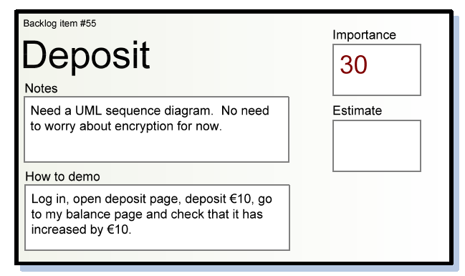
A sample Index Card

Slide 28
Iteration(Sprint )Planning
SCRUM projects make progress in a series of “Sprints” & XP projects call it as “Iterations”.
Duration of an iteration / sprint is usually one month +/- a week or two.
Product is designed, coded and tested during the sprint.
Sprint planning meeting at the beginning of every sprint for about 4-8 hours depending on sprint duration.

Slide 29
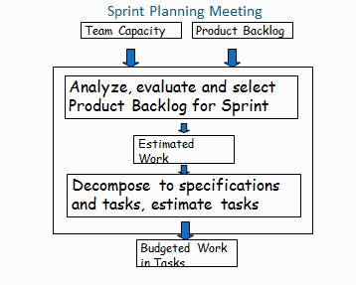
Continues..

Slide 30
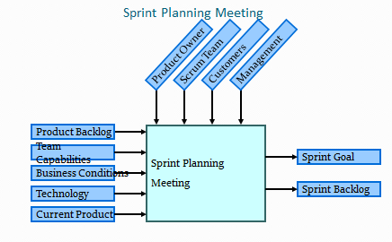

Slide 31
Continues..
Rules for Sprint Planning Meeting
Time boxed into 4 to 8 hours
Comprises of two segments of 2 to 4 hours each.
First segment is for selecting the product backlog..ie. select the user stories to be included in the sprint.
Second segment is for preparing sprint backlog. ie. identify the tasks for completing the selected user stories .
Participants
Scrum Master
Product Owner
Team
Additional parties can be invited (part time)

Slide 32
Continues..
Output of Sprint Planning Meeting
A Sprint Goal.
A Sprint Backlog.
A list of team members and their commitment levels.
A defined Sprint Demo Date.
A defined time and place for the daily Scrum meeting.
Index cards for user stories.

Slide 33
Tools for Agile project Management
Tracking Burndown chart (Discussed earlier)
Tracking Gantt Chart
Project Review Meetings
Daily Scrum Meeting
Scrum Planning Meeting
Scrum Review Meeting
Retrospective(looking back or review) Meeting

Slide 34
Gantt chart
Gantt chart was invented by a mechanical engineer named Henry Gantt in 1910.
It is a type of a bar chart that is used for illustrating project schedules.
It allow project managers to track the progress of the entire project.
The project manager can keep a track of the individual tasks as well as of the overall project progression.
It is used for tracking the utilization of the resources in the project.
The resources can be human resources as well as materials used.

Slide 35
Continues..
The project should have a sufficiently detailed Work Breakdown Structure (WBS).
The project should have identified its milestones and deliveries.
There are dozens of Gantt chart tools that can be used for successful project tracking. These tools usually vary by the feature offered.
Examples
Microsoft Excel
Microsoft Project Gantt Chart
Etc..

Slide 36
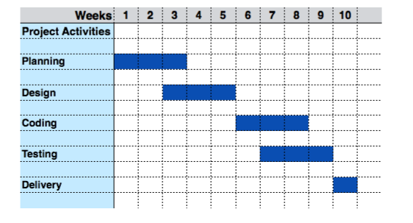
Continues..

Slide 37
Software Testing Principles
Definitions
Testing is the process of demonstrating that errors are not present.
The purpose of testing is to show that a program performs its intended functions correctly.
Testing is the process of establishing confidence that a program does what it is supposed to do.

Slide 38
Testing Principles
Serial No. | Principles
1 | A necessary part of a test case is a definition of the expected output or result.
2 | A programmer should avoid attempting to test his or her own program.
3 | A programming organization should not test its own programs.
4 | Thoroughly inspect the results of each test.
5 | Test cases must be written for input conditions that are invalid and unexpected, as well as for those that are valid and expected.
6 | Examining a program to see if it does not do what it is supposed to do is only half the battle; the other half is seeing whether the program does what it is not supposed to do.
7 | Avoid throwaway test cases unless the program is truly a throwaway program.
8 | Do not plan a testing effort under the tacit assumption that no errors will be found.
9 | The probability of the existence of more errors in a section of a program is proportional to the number of errors already found in that section.
10 | Testing is an extremely creative and intellectually challenging task.

Slide 39
Program Inspections, Walkthroughs and Reviews
Errors are not found only by machine execution.
Testers of software applications read code, but the concept of studying program code as part of a testing effort certainly is widely accepted.
By reading a program:-
The size or complexity of the application.
The size of the development team.
The timeline for application development.
The background and culture of the programming team.
That is why non-computerised testing(Human Testing).

Slide 40
Inspections and Walkthroughs
The two primary human testing methods are code inspections and walkthroughs.
A team of people reading or visually inspecting a program.
For that, participants must conduct some preparatory work.
There is “meeting of the minds,” at a participant conference.
The objective of the meeting is to find errors but not to find solutions to the errors. ie , to test, not debug.
It is effective only if people other than the program’s author are involved in the process.

Slide 41
Continues..
Advantage of walkthrough is reducing debugging (error-correction) costs.
If it is found as an error, it is very difficult to locate.
Computer-based testing normally exposes only a symptom of the error .
It is effective in finding from approximately 30 to 70 percent of the logic-design and coding errors in typical programs.
They are not effective, in detecting high-level design errors, such as errors made in the requirements-analysis process.

Slide 42
Code Inspection
A code inspection is a set of procedures and error-detection techniques for group code reading.
Code inspections focus on the procedures, forms to be filled out, and so on.
Inspection Team
Usually consists of four people.
One plays the role of moderator.
The moderator is expected to be a competent programmer.
Should not the author of the program.
Need not be familiar with the details of the program.
He/she is like a quality control engineer.
The duties of the moderator include
Distributing materials for, and scheduling, the inspection session.
Leading the session.
Recording all errors found.
Ensuring that the errors are subsequently corrected.
The others may be a programmer, designer and a test specialist.

Slide 43
Continues..
The moderator distributes the program’s listing and design specification to the other participants several days in advance of the inspection session.
The participants are expected to familiarize themselves with the material prior to the session.
During the session two activities occur:
The programmer narrates, statement by statement, the logic of the program. During the discourse, other participants should raise questions, and they should be pursued to determine whether errors exist. It is likely that the programmer rather than the other team members will find many of the errors found during this narration. In other words, the simple act of reading aloud a program to an audience seems to be a remarkably effective error-detection technique.
The program is analyzed with respect to a checklist of historically common programming errors.

Slide 44
Continues..
After the session
the programmer is given a list of the errors found.
If more than a few errors were found, or if any of the errors requires a substantial correction, the moderator might make arrangements to re-inspect the program after the errors are corrected.
This list of errors is also analysed, categorized, and used to refine the error checklist to improve the effectiveness of future inspections.
The time and location of the inspection should be planned to avoid all outside interruptions.
The optimal amount of time for the inspection session appears to be from 90 to 120 minutes.
Longer sessions tend to be less productive.
Most inspections proceed at a rate of approximately 150 program statements per hour. For that reason, large programs should be examined in multiple inspections, each inspection dealing with one or several modules or subroutines.
The ego state of the programmer is very important.

Slide 45
Continues..
An error checklist for inspection
Data reference errors
Data declaration errors
Computation errors
Comparison errors
Control-flow errors
Interface errors
Input/Output errors
Other checks

Slide 46
Walkthroughs
It is like inspection.
It is an uninterrupted meeting of one to two hours in duration.
Team consists of three to five people.
Roles
Any of these people plays the role of moderator.
One act as secretary.
Third person plays the role of a tester.
Suggestions for the other participants include
A highly experienced programmer.
A programming-language expert.
A new programmer (to give a fresh, unbiased outlook).
The person who will eventually maintain the program.
Someone from a different project.
Someone from the same programming team as the programmer.

Slide 47
Continues..
Identical to that of the inspection process, but the procedure is different.
The participants are given the materials several days in advance to allow them to bone up on the program.
Rather than simply reading the program or using error checklists, the participants “play computer.”
The person designated as the tester comes to the meeting armed with a small set of paper test cases—representative sets of inputs (and expected outputs) for the program or module.
During the meeting, each test case is mentally executed. That is, the test data are walked through the logic of the program.
The state of the program (i.e., the values of the variables) is monitored on paper or whiteboard.
This is for getting started and for questioning the programmer about his or her logic and assumptions.
In most walkthroughs, more errors are found during the process of questioning the programmer than are found directly by the test cases themselves.

Slide 48
Continues..
Desk checking
A desk check can be viewed as a one-person inspection or walkthrough.
A person reads a program, checks it with respect to an error list, and/or walks test data through it.
It is relatively unproductive because it is undisciplined process and it is ineffective in testing their own programs.
Peer Ratings
It is a technique of evaluating anonymous programs in terms of their overall quality, maintainability, extensibility, usability, and clarity.
The purpose of the technique is to provide programmer self-evaluation.

Slide 49
Continues..
Procedure
A programmer is selected to serve as an administrator of the process.
Team consists of approximately 6 to 20 participants.
Each participant is asked to select two of his or her own programs to be reviewed(one best work and one worst work).
Once the programs have been collected, they are randomly distributed to the participants.
Each participant is given four programs to review. Two of the programs are the “finest” programs and two are “poorer” programs, but the reviewer is not told which is which.
Each participant spends 30 minutes with each program and then completes an evaluation form after reviewing the program.
After reviewing all four programs, each participant rates the relative quality of the four programs. The evaluation form asks the reviewer to answer, on a 7 scale questionnaire.

Slide 50
Black Box Testing
Black box testing is a strategy in which testing is based solely on the requirements and specifications.
Requires no knowledge of the internal paths, structure, or implementation of the software under test (SUT).
The general black box testing process is:
The requirements or specifications are analysed.
Valid inputs are chosen based on the specification to determine that the SUT processes them correctly. Invalid inputs must also be chosen to verify that the SUT detects them and handles them properly.
Expected outputs for those inputs are determined.
Tests are constructed with the selected inputs.
The tests are run.
Actual outputs are compared with the expected outputs.
A determination is made as to the proper functioning of the SUT.

Slide 51
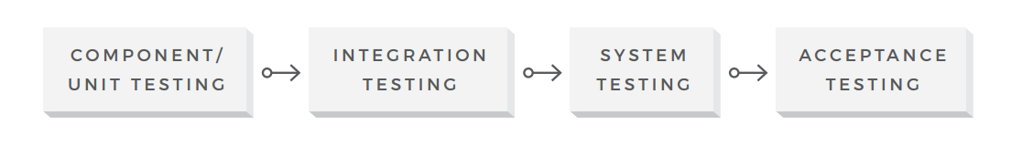
Levels of Black Box Testing
Black box testing can be applied at all levels of system development.

Slide 52
Disadvantages and Advantages
Disadvantages
The tester can never be sure of how much of the SUT has been tested.
Some execution paths may never be exercised.
It is impossible for the tester to create all possible combination of input data, both valid and invalid.
Advantages
Even though we can't test everything, formal black box testing directs the tester to choose subsets of tests that are both efficient and effective in finding defects.

Slide 53
Equivalence Class Testing
Example
If (applicantAge >= 0 && applicantAge <=16)
hireStatus="NO";
If (applicantAge >= 16 && applicantAge <=18)
hireStatus="PART";
If (applicantAge >= 18 && applicantAge <=55)
hireStatus="FULL";
If (applicantAge >= 55 && applicantAge <=99)
hireStatus="NO";
There is no need of testing all values.
Only one value needs to be tested in each range.
Any one within that range is just as good as any other one.
The same is true for each of the other ranges.
Ranges such as the ones described here are called equivalence classes.
An equivalence class consists of a set of data that is treated the same by the module or that should produce the same result. Any data value within a class is equivalent, in terms of testing, to any other value.

Slide 54
Continues..
If one test case in an equivalence class detects a defect, all other test cases in the same equivalence class are likely to detect the same defect.
A group of tests forms an equivalence class if you believe that:
They all test the same thing.
If one test catches a bug, the others probably will too.
If one test doesn't catch a bug, the others probably won't either.
Using equivalence test, the total 100 tests could be reduced to 4.
We will also check with invalid data.
In object oriented environment it is called Design By Contract.
Defensive Testing: an approach that tests under both normal and abnormal pre-conditions.

Slide 55
Boundary Value Testing
Boundary testing is the process of testing between extreme ends or boundaries between partitions of the input values.
Boundary value testing is a technique used to reduce the number of test cases to a manageable size while still maintaining reasonable coverage.
So these extreme ends like Start - End, Lower - Upper, Maximum -Minimum, Just Inside - Just Outside values are called boundary values and the testing is called ‘boundary testing’.

Slide 56
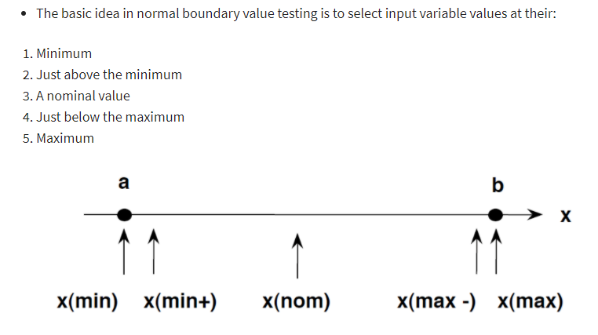
Continues..
Boundary value testing focuses on the boundaries because that is where so many defects hide.
Boundary Testing comes after the Equivalence Class Partitioning

Slide 57
Decision Table Testing
A Decision Table is a tabular representation of inputs versus rules / cases / test conditions.
It is a very effective tool used for both complex software testing and requirements management.
Decision table helps to check all possible combinations of conditions for testing and testers can also identify missed conditions easily.
Decision table testing is a software testing technique used to test system behavior for different input combinations.

Slide 58
Decision Table testing can be used whenever the system must implement complex business rules when these rules can be represented as a combination of conditions and when these conditions have discrete actions associated with them.
This is a systematic approach where the different input combinations and their corresponding system behavior (Output) are captured in a tabular form
That is why it is also called as a Cause-Effect table where Cause and effects are captured for better test coverage

Slide 59
Continues..
Decision tables are an excellent tool to capture certain kinds of system requirements and to document internal system design.
Conditions 1 through m represent various input conditions. Actions 1 through n are the actions that should be taken depending on the various combinations of input conditions. Each of the rules defines a unique combination of conditions that result in the execution ("firing") of the actions associated with that rule.

Slide 60
Pairwise Testing
Pairwise Testing also known as All-pairs testing is a testing approach taken for testing the software using combinatorial method.
When the number of combinations to test is very large, do not to attempt to test all combinations for all the values for all the variables, but test all pairs of variables. This significantly reduces the number of tests that must be created and run.
It's a method to test all the possible discrete combinations of the parameters involved.

Slide 61
Continues..
Assume we have a piece of software to be tested which has got 10 input fields and 10 possible settings for each input field, then there are 10¹⁰ possible inputs to be tested.
In this case, exhaustive testing is impossible even if we wish to test all combinations.
Example: If a system had four different input parameters and each one could take on one of three different values, the number of combinations is 3⁴ which is 81. It is possible to cover all the pairwise input combinations in only nine tests.

Slide 62
State Transition Testing
State Transition Testing is a black box testing technique in which changes made in input conditions cause state changes or output changes in the Application under Test (AUT).
State-Transition diagrams is an excellent tool to capture certain types of system requirements and to document internal system design.
These diagrams document the events that come into and are processed by a system as well as the system's responses.

Slide 63
Continues..
When a system must remember something about what has happened before or when valid and invalid orders of operations exist, state-transition diagrams are excellent tools to record this information.
State transition testing helps to analyze behaviour of an application for different input conditions.
Testers can provide positive and negative input test values and record the system behaviour.
State Transition Testing Technique is helpful where you need to test different system transitions.

Slide 64
Continues..
State (represented by a circle)-A state is a condition in which a system is waiting for one or more events. States "remember" inputs the system has received in the past and define how the system should respond to subsequent events when they occur. These events may cause state-transitions and/or initiate actions.
Transition (represented by an arrow)-A transition represents a change from one state to another caused by an event.
Event (represented by a label on a transition)-An event is something that causes the system to change state. Generally, it is an event in the outside world that enters the system through its interface.
Action (represented by a command following a "/")-An action is an operation initiated because of a state change.
The entry point on the diagram is shown by a black dot while the exit point is shown by a bulls-eye symbol.

Slide 65
Continues..

Slide 66
Use-Case Testing
A use case is a scenario that describes the use of a system by an actor to accomplish a specific goal.
A scenario is a sequence of steps that describe the interactions between the actor and the system.
Use cases are made on the basis of user actions and the response of the software application to those user actions.
The set of use cases makes up the functional requirements of a system.

Slide 67
Continues..
An actor is a user, playing a role with respect to the system, seeking to use the system to accomplish something worthwhile within a particular context.
By "actor" we mean a user, playing a role with respect to the system, seeking to use the system to accomplish something worthwhile within a particular context.
Actors are generally people although other systems may also be actors.
The use case is defined from the perspective of the user, not the system.
It is widely used in developing test cases at system or acceptance level

Slide 68
Continues..
Use Case Testing is a software testing technique that helps to identify test cases that cover entire system on a transaction by transaction basis from start to end.
Test cases are the interactions between users and software application
The Unified Modeling Language notion for use cases is:
The stick figures represent the actors, the ellipses represent the use cases, and the arrows show which actors initiate which use cases.

Slide 69
White-Box Testing
Tests the data flow and control flow.
Structural testing, Clear box testing, Code-based testing, and Transparent testing and Glass box testing.
It is a strategy in which testing is based on the internal paths, structure, and implementation of the software under test.
White box testing generally requires detailed programming skills.
One of the basic goals of white-box testing is to verify a working flow for an application.

Slide 70
Continues..
Another type of testing is Gray box testing.
Grey Box Testing is also known as translucent testing as the tester has limited knowledge of coding.
Gray Box Testing is a software testing method, which is a combination of both White Box Testing and Black Box Testing method.
Grey Box Testing is a software testing technique to test a software product or application with partial knowledge of internal structure of the application.
The purpose of grey box testing is to search and identify the defects due to improper code structure or improper use of applications.

Slide 71
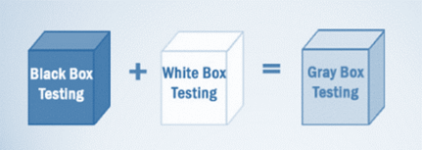
Continues..
In White Box testing internal structure (code) is known.
In Black Box testing internal structure (code) is unknown.
In Grey Box Testing internal structure (code) is partially known.

Slide 72
Continues..
White box testing is a strategy in which testing is based on the internal paths, structure, and implementation of the software under test (SUT).
White box testing is more than code testing—it is path testing.
Generally, the paths that are tested are within a module (unit testing).
We can apply the same techniques to test paths between modules within subsystems, between subsystems within systems, and even between entire systems.

Slide 73
Continues..
How do you perform White Box Testing?
Step 1) Understand the source code
Step 2) Create test cases and Execute

Slide 74
Continues..
Disadvantages
The number of execution paths may be so large than they cannot all be tested. Attempting to test all execution paths through white box testing is generally as infeasible.
The test cases chosen may not detect data sensitivity errors.
White box testing assumes the control flow is correct (or very close to correct).
The tester must have the programming skills to understand and evaluate the software under test.
Advantages: When using white box testing, the tester can be sure that every path through the software under test has been identified and tested.

Slide 75
Continues..
White Box Testing Techniques
Control Flow Testing
Data Flow Testing

Slide 76
Control Flow Testing
Control flow testing identifies the execution paths through a module of program code and then creates and executes test cases to cover those paths.
Path: A sequence of statement execution that begins at an entry and ends at an exit.
The aim of Control flow testing technique is to determine the execution order of statements or instructions of the program through a control structure.
The control structure of a program is used to develop a test case for the program.
In this technique, a particular part of a large program is selected by the tester to set the testing path

Slide 77
Continues..
Test cases are represented by the control graph of the program.
Control flow graphs are the foundation of control flow testing. These graphs document the module's control structure. Modules of code are converted to graphs, the paths through the graphs are analyzed, and test cases are created from that analysis.
Control Flow Graph is formed from the node, edge, decision node, junction node to specify all possible execution path.

Slide 78
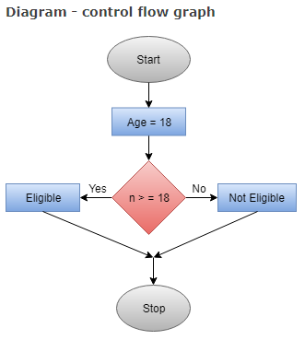
Continues..
Notations used for Control Flow Graph
Node : Used to create a path of procedures. Basically, it represents the sequence of procedures
Edge : Used to link the direction of nodes
Decision Node : Used to decide next node of procedure as per the value
Junction node : Point where at least three links meet

Slide 79
Continues..
Control flow testing is the cornerstone of unit testing.
It should be used for all modules of code that cannot be tested sufficiently through reviews and inspections.
Its limitations are that the tester must have sufficient programming skill to understand the code and its control flow.
In addition, control flow testing can be very time consuming because of all the modules and basis paths that comprise a system.

Slide 80
Data Flow Testing
Data flow testing is a powerful tool to detect improper use of data values due to coding errors.
Data Flow Testing is a specific strategy of software testing that focuses on data variables and their values
Variables that contain data values have a defined life cycle. They are created, they are used, and they are killed (destroyed).

Slide 81
Continues..
A data flow graph is similar to a control flow graph in that it shows the processing flow through a module.
We will construct these diagrams and verify that the define-use-kill patterns are appropriate.
First, we will perform a static test of the diagram. By "static" we mean we examine the diagram (formally through inspections or informally through look-sees).
Second, we perform dynamic tests on the module. By "dynamic" we mean we construct and execute test cases.

Slide 82
Continues..
It keeps a check at the data receiving points by the variables and its usage points.
The process is conducted to detect the bugs because of the incorrect usage of data variables or data values.
A common programming mistake is referencing the value of a variable without first assigning a value to it.
Data flow testing builds on and expands control flow testing techniques.
As with control flow testing, it should be used for all modules of code that cannot be tested sufficiently through reviews and inspections.

Slide 83
Continues..
Its limitations are that the tester must have sufficient programming skill to understand the code, its control flow, and its variables.
Like control flow testing, data flow testing can be very time consuming because of all the modules, paths, and variables that comprise a system.

Slide 84
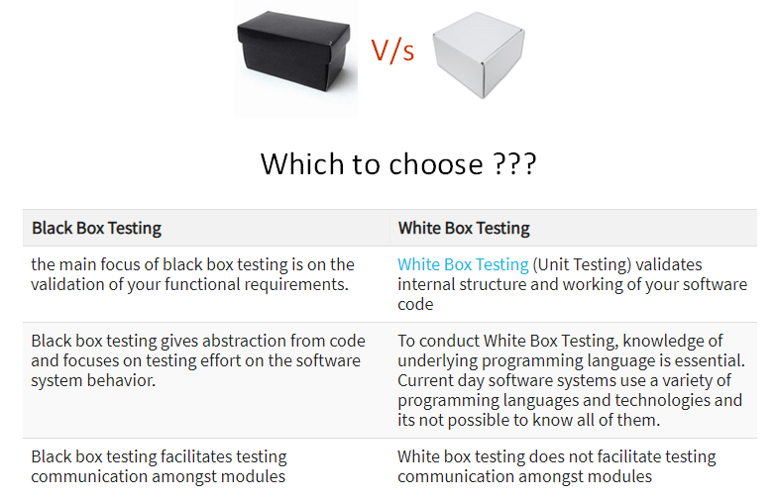
Comparison of Black Box and White Box Testing:

Slide 85
Automation Testing
Types of automation testing:
Unit Testing
Functional Testing
Integration Testing
Regression Testing
Smoke Testing - Smoke testing is performed to examine whether the deployed build is stable or not.

Slide 86
Continues..
Test Automation is the best way to increase the effectiveness, test coverage, and execution speed in software testing.
Why Automation testing?
Manual Testing of all workflows, all fields, all negative scenarios is time and money consuming
It is difficult to test for multilingual sites manually.
Test Automation does not require Human intervention. You can run automated test unattended (overnight).
Test Automation increases the speed of test execution.
Automation helps increase Test Coverage.
Manual Testing can become boring and hence error-prone.

Slide 87
Which Test Cases to Automate?
Test cases to be automated can be selected using the following criterion:
High Risk - Business Critical test cases
Test cases that are repeatedly executed
Test Cases that are very tedious or difficult to perform manually
Test Cases which are time-consuming

Slide 88
Which test cases are not suitable for automated testing?
The following category of test cases are not suitable for automation:
Test Cases that are newly designed and not executed manually at least once
Test Cases for which the requirements are frequently changing
Test cases which are executed on an ad-hoc basis.

Slide 89
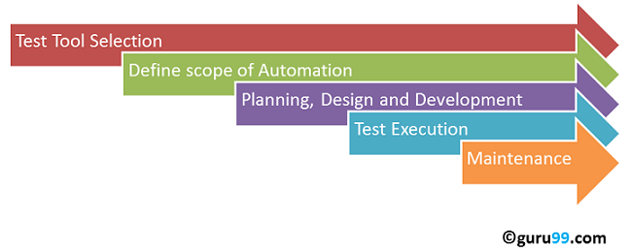
Automated Testing Process
Following steps are followed in an Automation Process:
Step 1. Test Tool Selection.
Step 2. Define scope of Automation.
Step 3. Planning, Design and Development.
Step 4. Test Execution.
Step 5. Maintenance.

Slide 90
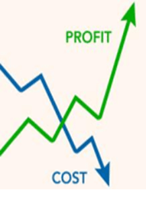
Advantages of Automated Testing.
70% faster than the manual testing.
Wider test coverage of application features.
Reliable in results.
Ensure Consistency.
Saves Time and Cost.
Improves accuracy.
Human Intervention is not required while execution.
Increases Efficiency.
Better speed in executing tests.
Re-usable test scripts.
Test Frequently and thoroughly.
More cycle of execution can be achieved through automation.
Early time to market.

Slide 91
Defect life cycle
Bug life cycle.
It is a cycle which a defect goes through different stages throughout its entire lifetime, during the test process.
It starts when defect is found (when reported by the tester ) and ends when a tester ensures that a defect is closed, after ensuring that the issue is fixed and won't occur again.
Defect Status (Bug Status) in defect life cycle is the present state from which the defect or a bug is currently undergoing.
The goal of defect status is to precisely convey the current state or progress of a defect or bug in order to better track and understand the actual progress of the defect life cycle.

Slide 92
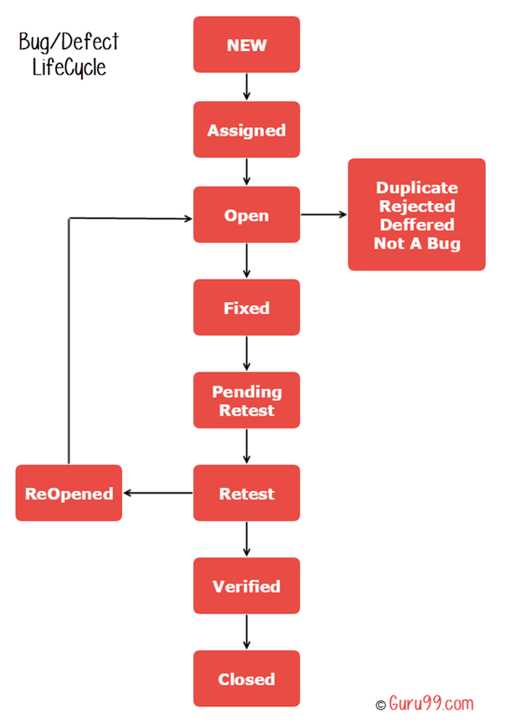
Continues..

Slide 93
Continues..
The number of states that a defect goes through varies from project to project.
Lifecycle diagram given in the previous slide covers all possible states.
New: When a new defect is logged and posted for the first time. It is assigned a status as NEW.
Assigned: Once the bug is posted by the tester, the lead of the tester approves the bug and assigns the bug to the developer team.
Open: The developer starts analysing and works on the defect fix.
Fixed: When a developer makes a necessary code change and verifies the change, he or she can make bug status as “Fixed”.

Slide 94
Continues..
Pending retest: Once the defect is fixed the developer gives a particular code for retesting the code to the tester. Since the software testing remains pending from the testers end, the status assigned is “pending retest”.
Retest: Tester does the retesting of the code at this stage to check whether the defect is fixed by the developer or not and changes the status to “Re-test”.
Reopen: If the bug persists even after the developer has fixed the bug, the tester changes the status to “reopened”. Once again the bug goes through the life cycle.

Slide 95
Continues..
Closed: If the bug is no longer exists then tester assigns the status “Closed”.
Duplicate: If the defect is repeated twice or the defect corresponds to the same concept of the bug, the status is changed to “duplicate”.
Verified: The tester re-tests the bug after it got fixed by the developer. If there is no bug detected in the software, then the bug is fixed and the status assigned is “verified”.

Slide 96
Continues..
Rejected: If the developer feels the defect is not a genuine defect then it changes the defect to “rejected”.
Deferred: If the present bug is not of a prime priority and if it is expected to get fixed in the next release, then status “Deferred” is assigned to such bugs
Not a bug: If it does not affect the functionality of the application then the status assigned to a bug is “Not a bug”.

Slide 97
Continues..
In Agile development, testing needs to happen early and often.
So, instead of waiting for development to be finished before testing begins, testing happens continuously as features are added.
Tests are prioritized just like user stories.
Testers aim to get through as many tests as they can in an iteration.

Slide 98
Regression Testing
The purpose of regression testing is to verify if code change introduces issues/defects into the existing functionality.
There are so many kinds of possible changes that can impact the existing functionality in an application system.
Even the simplest change to the code could impact previously tested functionality.
Regression testing is performed when there is a code change in a software application.

Slide 99
Continues..
Regression testing:- Test the program's entire functionality to see if any thing changed when you added new code to the project.
Regression testing (which can also be performed at the unit level) is used to validate the updated software against the old set of test cases that have already been passed.
Regression testing helps to ensure that changes (due to testing or for other reasons) do not introduce unintended behavior or additional errors.

Slide 100
Testing Non-Functional Requirements.
It a type of software testing to check non-functional aspects (performance, usability, reliability, etc) of a software application.
It is designed to test the readiness of a system as per non-functional parameters which are never addressed by functional testing.

Slide 101
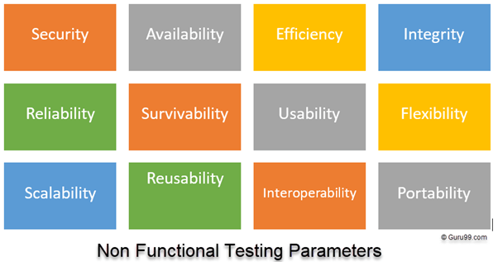
Continues..

Slide 102
Continues..
Baseline testing
Compliance testing
Documentation testing
Endurance testing or reliability testing
Load testing
Scalability testing
Stress testing
Usability testing
Volume testing
Compatibility testing
Localization testing and Internationalization testing
Performance testing
Recovery testing
Resilience testing
Security testing

Slide 103
Continues..
Performance and scalability. How fast does the system return results? How much will this performance change with higher workloads?
Portability and compatibility. Which hardware, operating systems, browsers, and their versions does the software run on? Does it conflict with other applications and processes within these environments?
Reliability, availability, maintainability. How often does the system experience critical failures? and how much time is it available to users against downtimes?
Security. How are the system and its data protected against attacks?
Localization. Does the system match local specifics?
Usability. How easy is it for a customer to use the system?

